Slide 1
Employee Data Analysis using Excel
STUDENT NAME: ZUBIAR KHAN N
REGISTER NO: 312214560/B7610039EA5D704AD95486A1F4D5E687
DEPARTMENT: B.COM(COMPUTER APPLICATION)
COLLEGE:ST THOMAS COLLEGE OF ARTS AND SCIENCE

Slide 2
PROJECT TITLE
Visualizing employee attendance trende with excel chats

Slide 3


AGENDA
Problem Statement
Project Overview
End Users
Our Solution and Proposition
Dataset Description
Modelling Approach
Results and Discussion
Conclusion
3/21/2024 Annual Review

Slide 4

PROBLEM STATEMENT
*To effectively visualize and analyze employee attendance data over time using Excel charts.
*The goal is to identify patterns, trends, and anomalies in attendance, which can aid in decision-making regarding workforce management and policy adjustments

Slide 5

PROJECT OVERVIEW
.
*To analyze and visualize employee attendance data using Excel charts to identify trends, patterns, and areas for improvement.
*Gather employee attendance data, including dates, employee names, and attendance status (e.g., present, absent, late).

Slide 6

WHO ARE THE END USERS?
*HR Managers:
To monitor attendance patterns, track absences, and ensure compliance with company policies.
*Team Leaders/Supervisors:
To manage day-to-day staffing needs, identify attendance issues, and address productivity concerns.
*Operations Managers:
To optimize resource allocation and adjust staffing levels based on attendance trends
.
*Finance Departments:
To analyze the financial impact of attendance patterns, such as overtime costs or productivity losses.

Slide 7
OUR SOLUTION AND ITS VALUE PROPOSITION
~Our solution offers a comprehensive approach to visualizing employee attendance trends using Excel charts. By integrating data analysis with clear graphical representations, we make it easier for organizations to monitor attendance patterns and identify trends over time.

Slide 8
Dataset Description
~ Kaagle-employee dataset
~ 26 feature
~ 9featuresEmp id- numerical
~ Fn- text
~ Ln- text
~ Business unit-text
~ Gender-male,female
~ Performance score- text

Slide 9

THE "WOW" IN OUR SOLUTION
* IFS(Z8>=5,"VERY HIGH",Z8>=4,"HIGH",Z8>=3, "MED', TRUE,"LOW")
3/21/2024 Annual Review
9

Slide 10
MODELLING
*Prepare Your Data:Data Collection: Ensure you have data on employee attendance, including dates, employee IDs/names, and attendance status (e.g., present, absent, late).
*Data Organization: Structure your data in a table format with columns for Date, Employee ID/Name, and Attendance Status. Include additional columns if needed (e.g., Department)
10

Slide 11
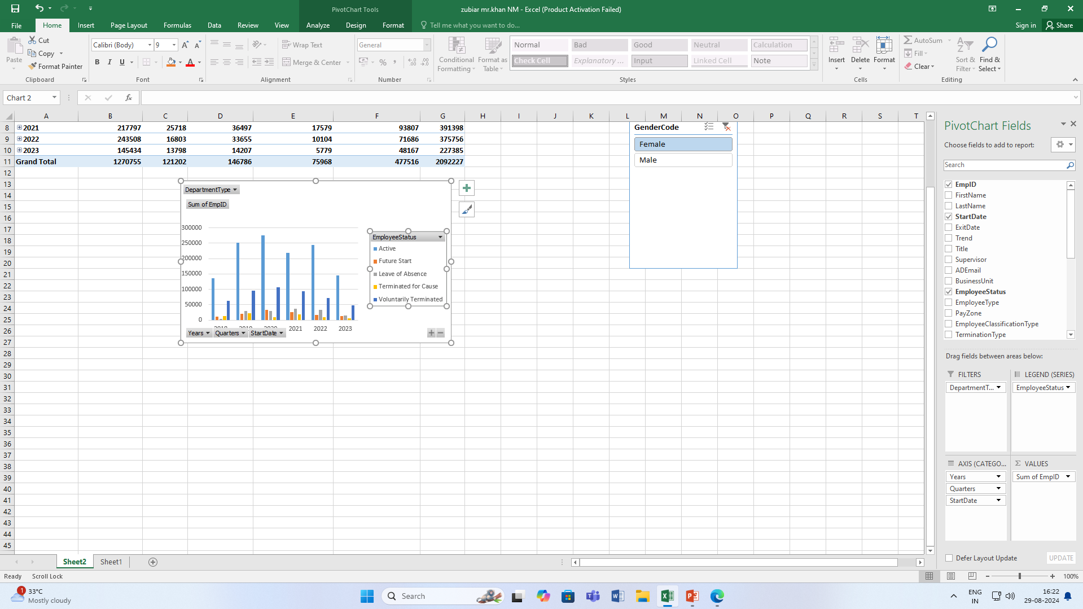
RESULT

Slide 12
RESULTS
12

Slide 13
conclusion
conclusion, By using pivot tables and dynamic charts such as line, column, and stacked column charts, you can clearly illustrate attendance patterns, compare different data points, and highlight trends over time. This approach not only simplifies complex data but also provides actionable insights into attendance management.

